Slide 1
ERCOT Market Data Processing Improvements
Stephen Xu & Pranil Walke
07/26/2023

Slide 2
Moving away from legacy excel based tool to new automated Python
Original version created in 2015
Transition from web scraping to API pull - 2021
“Planned” Retirement -2023
Evolution of ERCOT Market Data Downloads
Objective
Current State | Proposed State
Excel VBA Based | Python Based
Minimal documentation | Detailed Documentation
Non-existent logging | Detailed email capability to help with troubleshooting
Doesn’t work for many folders | Should work for all folders with available data
Slow: Takes up to an hour | Fast: Aim for 7-8x Speedups

Slide 3
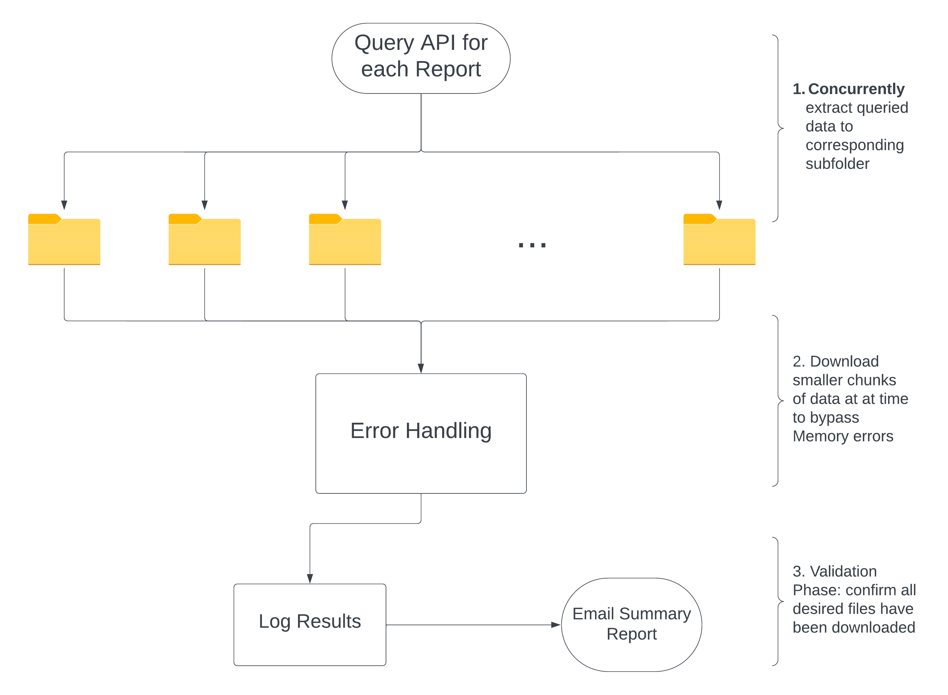
Concurrent Downloading , Advanced Error Handling, and Summary Report
Downloads over 100 reports, includes everything from 5-min data to planning reports

Slide 4
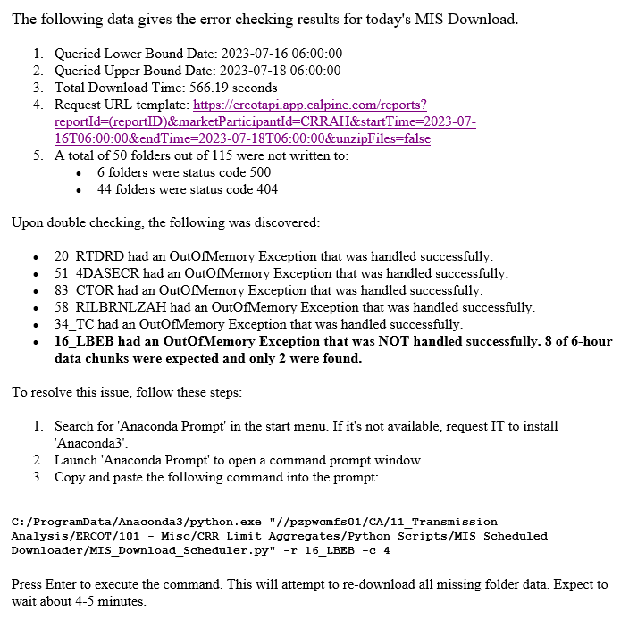
Detailed Summary Report, Tips For Troubleshooting
Automated to send immediately after the data gets downloaded (roughly 6:25 AM)
Detailed summary email
Provides Useful Troubleshooting Tips and Tricks
Offers an easy solution via the Command Line to manually download missing data

Slide 5
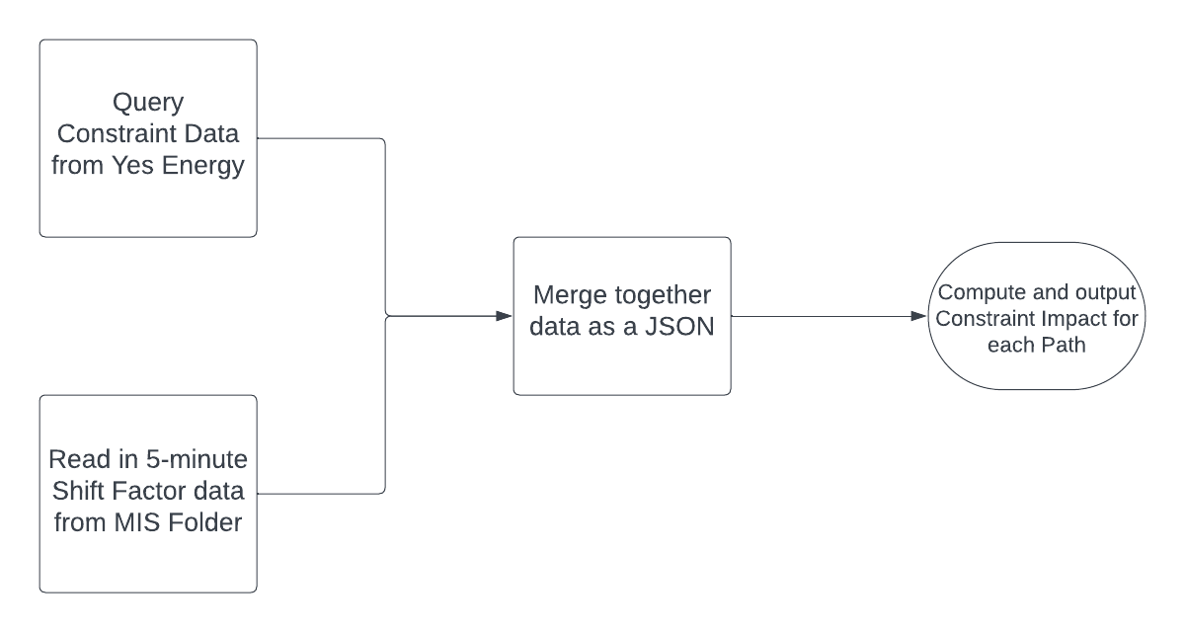
Interactive Report: Real Time Constraint Impact
Automated historical constraint analysis for Calpine’s Asset
Morning Meeting Question(s)
Will the basis from yesterday/last 2 days repeat today/tomorrow
Pricing PTP (spread bids)
Current Process | Changed
Manual Lookup Constraint Table | One Shot Fully Automated Python based scheduled task
Manual Lookup Shift Factor Table
Time Spent ~ 10 minutes | Time Spent : < 1 minute

Slide 6
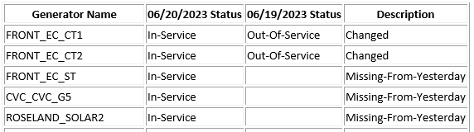
Automated Generator Availability Report
ERCOT’s DA Market is a voluntary Market : Generator Availability is key to forecasting DA Market
Sample Report
Next Steps
Replace Generator Code by English Names
Add Size, Fuel Type
DA Network Zip Files published at 5am
Unzip, aggregate & compare last 2 days
Email summary of the results

